Slide 1





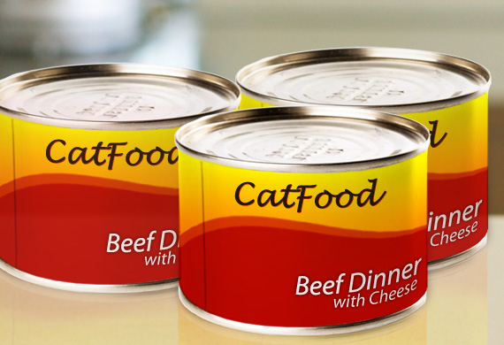

Verify that the image contains proper food with Google Cloud Vision API
Main function
Secondary function
If the cat was hungry and now he is fed, activate the second function to send an email notification that the cat has been fed.
After a picture has been uploaded, activate the function to update the cat status.
If necessary, sends an email
Update the last feeding time and checks if the feeding came after a hunger period
Check last feeding time and feeding period to see if an email reminder to feed the cat needs to be sent
Runs every 15 minutes
Upload a picture to an amazon s3 bucket

